Slide 1

Esfinge AOM RoleMapper Neo4j Persistence
INPE CAP 385 Desenvolvimento de Frameworks
2º Período / 2016
Luiz Wagner Tavares Nascimento
nascimentolwtn@gmail.com

Slide 2
Esfinge AOM RoleMapper Neo4J
Introdução
Setup
Ciclo de Vida
Exemplos
Resumo mudanças JUnit 4 p/ JUnit 5

Slide 3
Introdução
Neo4j – Graphs
Neo4j OGM
Neo4j Doc Manage
It is intended for live one-way syncronization from MongoDB to Neo4j, where you have both databases running and take advantage of each databases' strength in your application (polyglot persistance).

Slide 4
SQL vs MongoDB vs Neo4j
MySQL is best is you're looking for a tried and true system. One that's been around for a while, is trusted, and has an extremely large support network.
MongoDB is gaining popularity in the tech community because it uses objects, a common construct across all programming languages. If you understand JSON style objects and dot notation, you can start using Mongo. It's also extremely convenient that related data is stored in a single document. I don't need join tables because everything is in one place.
However, I find it difficult to create complex queries. If you're looking to chain queries (match this and this and this), you're going to need to do quite a bit of research and test different methods for performance. Often, the easiest solution is to duplicate data, but this just feels dirty.
MongoDB is great if you want to jump onto a quickly rising ship. Mongo is sponsored and supported by a ton of great organizations and is rapidly becoming a default for many new projects (it's the M in the popular MEAN stack). Most use cases are pretty straightforward to accomplish and its schema is very flexible.
Neo4j, though not technically a relational database, is phenomenal for any project where the relationships between data elements is just as important as the data itself. It automatically indexes popular nodes, so your queries will actually get faster more times they're run.
If you choose to use Neo4j, be prepared for a lot of trial and error. Neo4j v1 was release in 2010 and v2 just came out a few months ago, so don't expect the feature rich experience of MySQL. The community is growing, but there just aren't nearly as many posts about how to resolve specific problems, so you'll need to be ready to tinker to accomplish your goals.
Use Neo4j if you want to answer semantic type questions. Facebook uses a graph database to allow you write things like "Show me restaurants in Paris that my friends liked". This query would be tough in MySQL or Mongo, but is insanely easy in Neo4j. It's also really fun to be on the forefront of a new and growing technology.
http://addisonlee.azurewebsites.net/neo4j-vs-mysql-vs-mongodb/

Slide 5
AOM RoleMapper (Neo4J) – TypeSquare
MATCH (n:`org.esfinge.aom.model.rolemapper.core.AdapterEntity`) RETURN n
MATCH (n:`org.esfinge.aom.model.rolemapper.core.AdapterEntity`)-[r]-() RETURN r
MATCH (n:`org.esfinge.aom.model.rolemapper.core.AdapterEntity`)<-[r*1..4]->() RETURN r

Slide 6
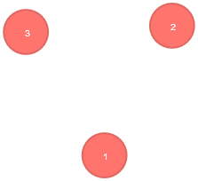
AOM RoleMapper (Neo4J) – Entity

Slide 7
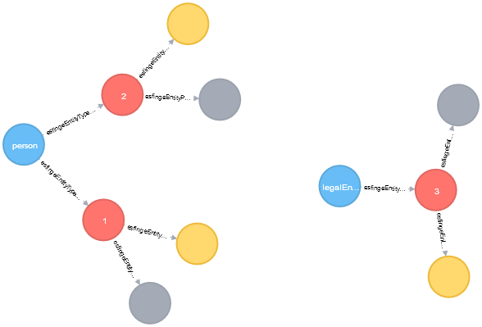
AOM RoleMapper (Neo4J) – EntityType

Slide 8
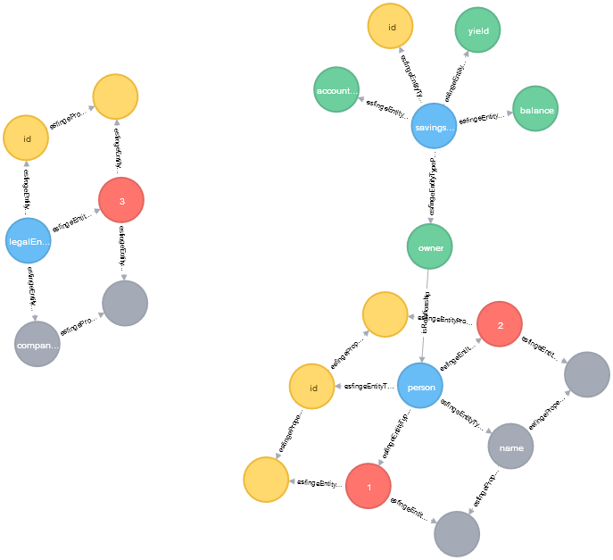
AOM RoleMapper (Neo4J) – TypeSquare

Slide 9

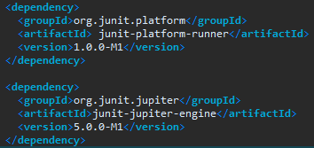
JUnit 5 - Setup
Código de Testes
Runner

Slide 10
Resumo Mudanças JUnit 4 -> JUnit 5
Uso das anotações do pacote org.junit.jupiter.api (Assertions, Assumptions)
Migração com @RunWith(JUnitPlatform.class)
JUnit 4 | JUnit 5
@BeforeClass | @BeforeAll
@Before | @BeforeEach
@After | @AfterEach
@AfterClass | @AfterAll
@Ignore | @Disabled
@Category | @Tag
@RunWith | @ExtendWith
@Rule
@ClassRule

Slide 11
Obrigado!
FIM
Slides extras – Benchmark Neo4J

Slide 12

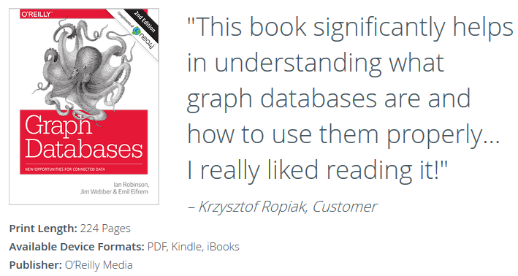
Free Book
https://neo4j.com/graph-databases-book/

Slide 13
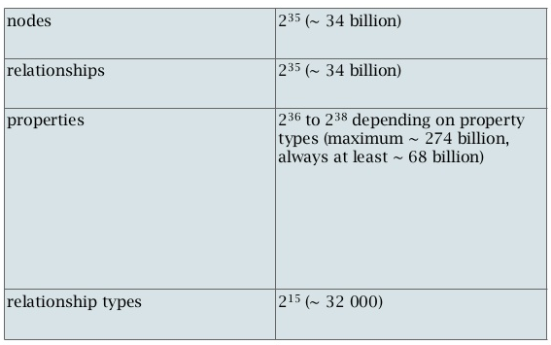
3.x - Data Size
http://www.slideshare.net/aliraza995/neo4j-graph-storage-27104408/21

Slide 14
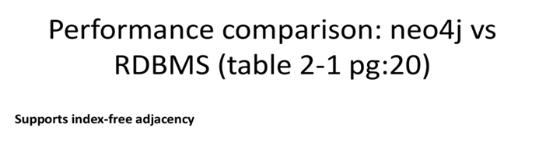

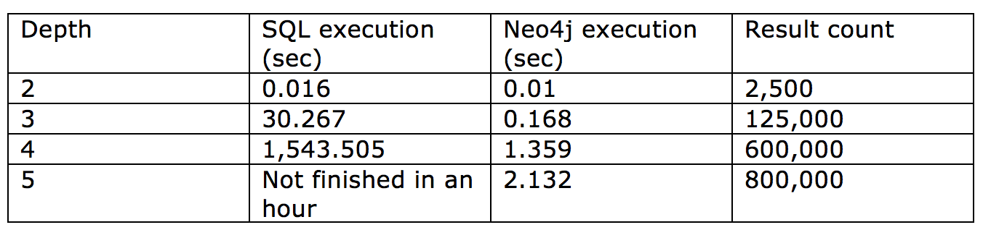
RDMBS vs Neo4J
http://www.slideshare.net/aliraza995/neo4j-graph-storage-27104408/21

Slide 15
Neo4J - Java API vs Cypher Performance
https://dzone.com/articles/get-full-neo4j-power-using

